Slide 1
Biomolecules: Carbohydrates

Slide 2
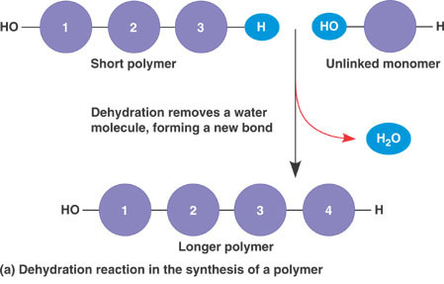
Dehydration Synthesis
Building reaction
H₂O is removed in order to form a new bond

Slide 3
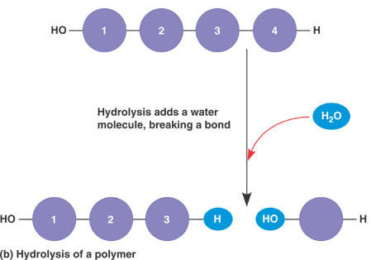
Hydrolysis Reaction
Breaking reaction
H₂O is required to break a bond

Slide 4
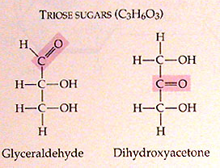
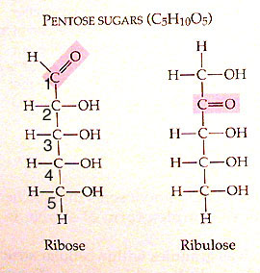
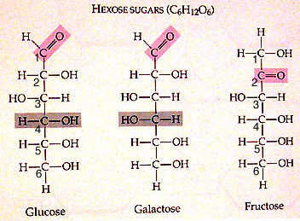
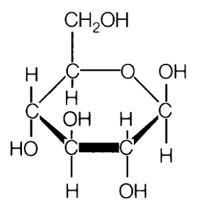
Carbohydrates
Biological roles
  Energy
  Cell to cell recognition
  Etc.
Monosaccharide = Monomer
1:2:1 ratio of C:H:O
  C₆H₁₂O₆

Slide 5
Disaccharides
2 monosaccharides linked together
Key disaccharides you need to know:
  Fructose + glucose → sucrose + H₂O
  Glucose + galactose → lactose + H₂O
  Glucose + glucose → maltose + H₂O

Slide 6
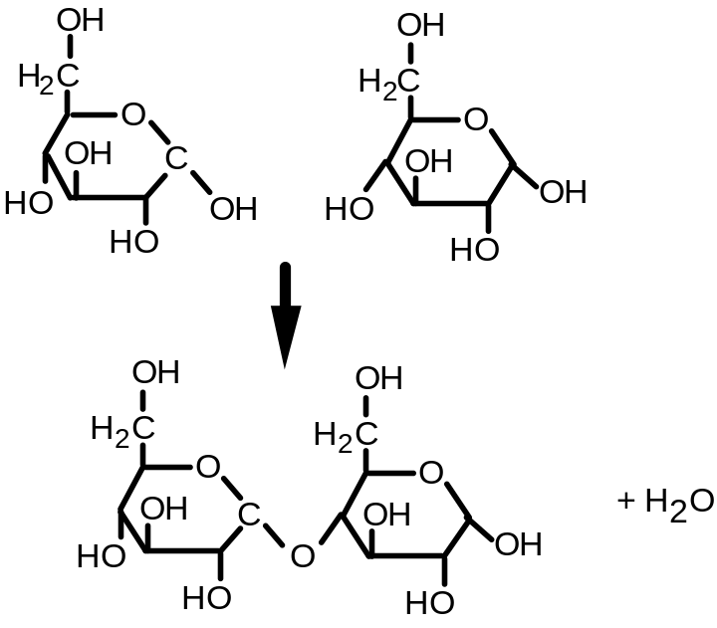
Glycosidic linkage
The bond between monosaccharides
What type of reaction would form this bond?
  Dehydration reaction
What kind of bond is a glycosidic linkage?
  Polar covalent

Slide 7
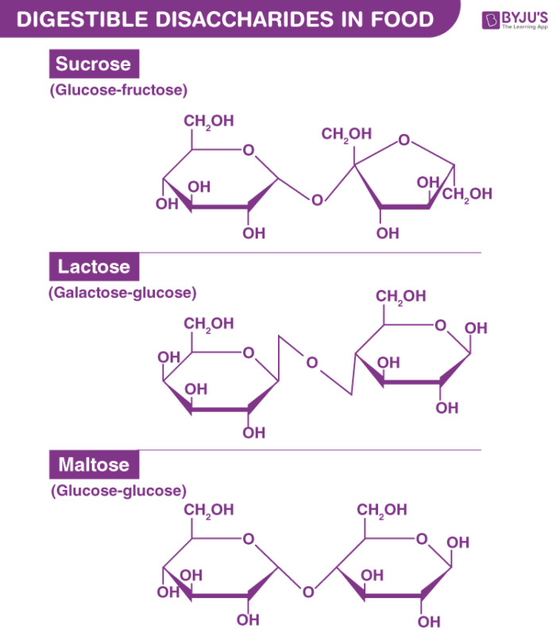

Slide 8
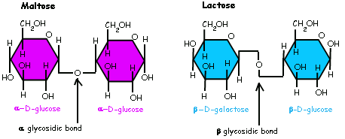

Slide 9
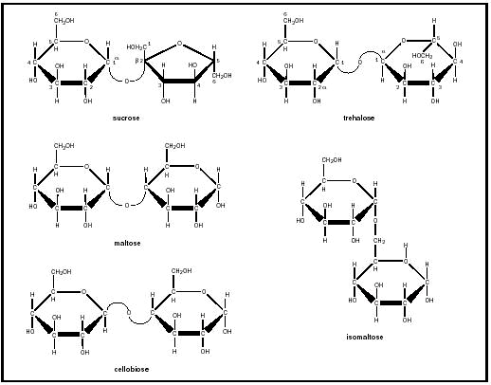

Slide 10
Polysaccharides: Starch & Glycogen
Both are used for energy storage
  Starch = energy storage in plants
  Glycogen = energy storage in animals
When energy is needed, enzymes break the bonds between monosaccharides

Slide 11
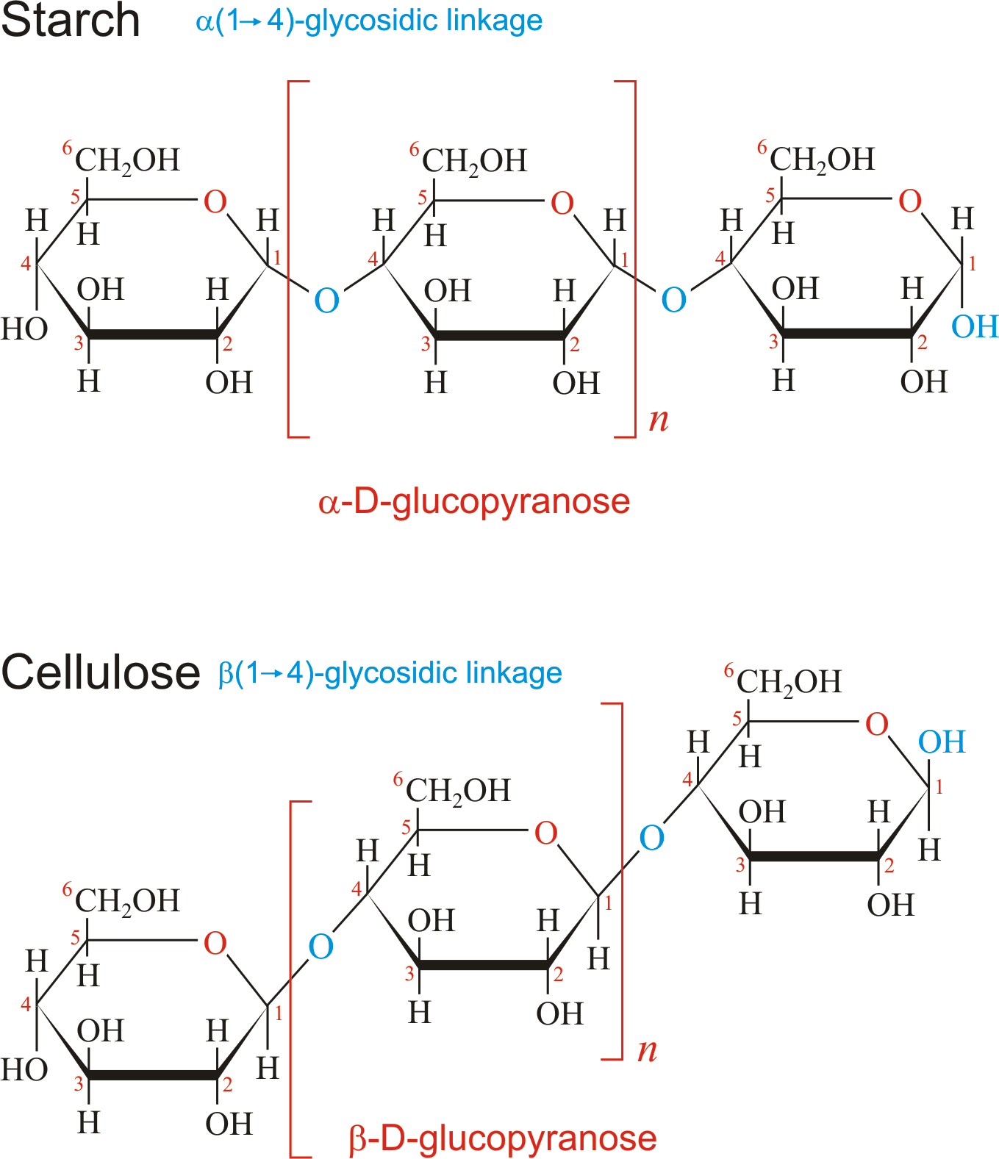

Slide 12
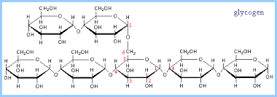
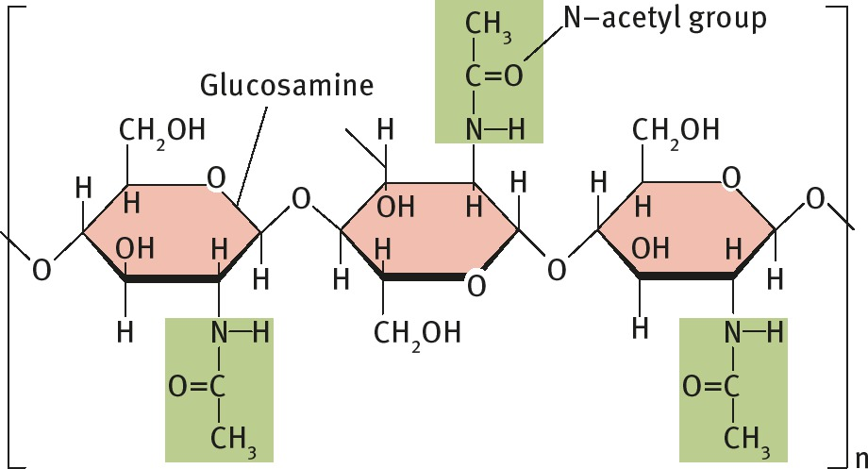

Slide 13
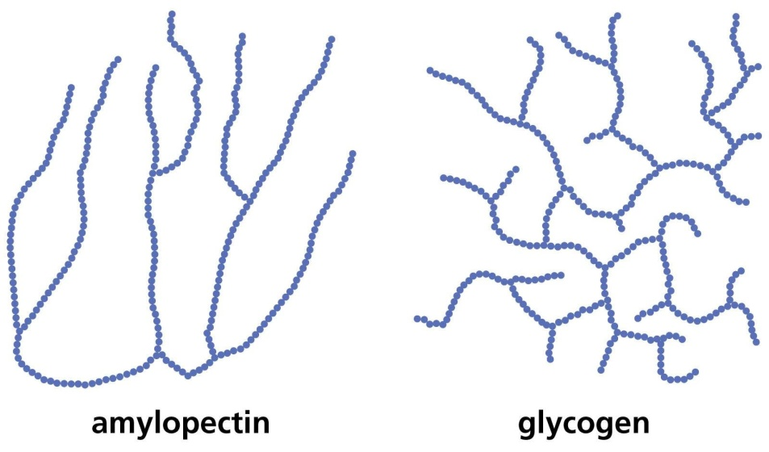
Structure of Starch & Glycogen
Branched structure
  How does the branched structure support the function of these molecules?
  branching allows for more points of access for enzymes to act (greater surface area)

Slide 14
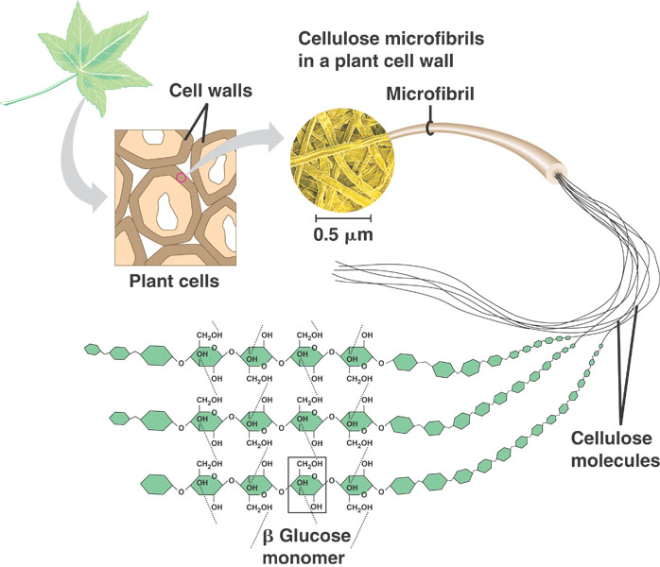
Polysaccharides: Cellulose + Chitin
For structural support
  Cellulose = structural support in plants
  Chitin = makes up the hard exoskeleton of insects

Slide 15
Structure of Cellulose & Chitin
Long, unbranched chains
  Fibers form parallel chains
  How would the structure of cellulose & chitin support their functions?
  Long, unbranched chains provide greater strength

Slide 16
Metabolism
Catabolism: Breaking down of molecules
Anabolism: Building up of molecules
(ATP is the energy currency used by these reactions)

Slide 17
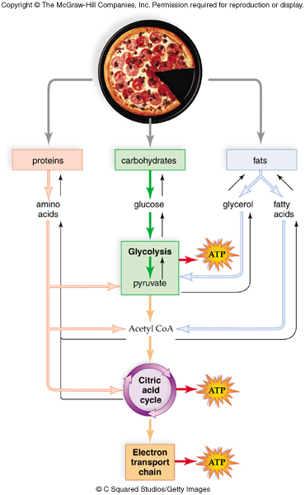

Slide 18
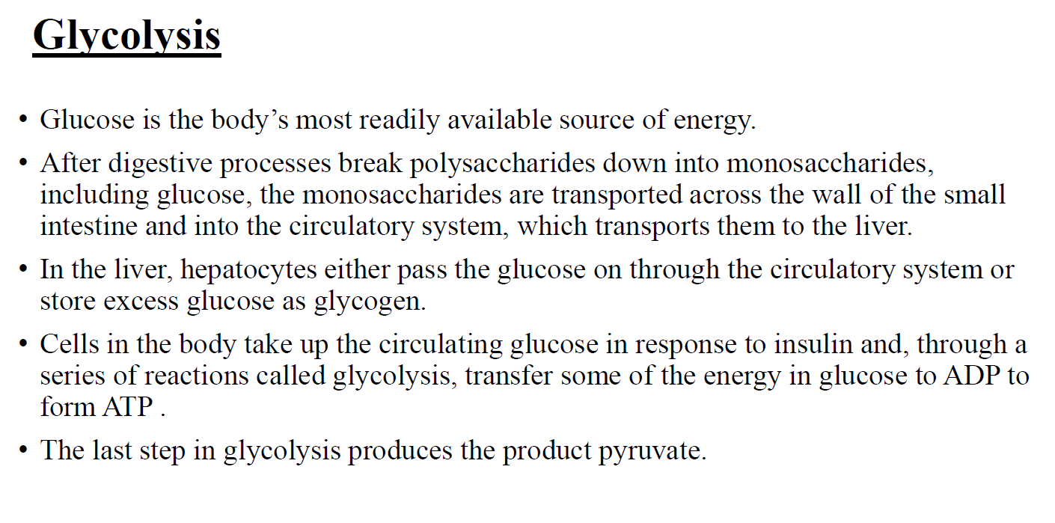

Slide 19
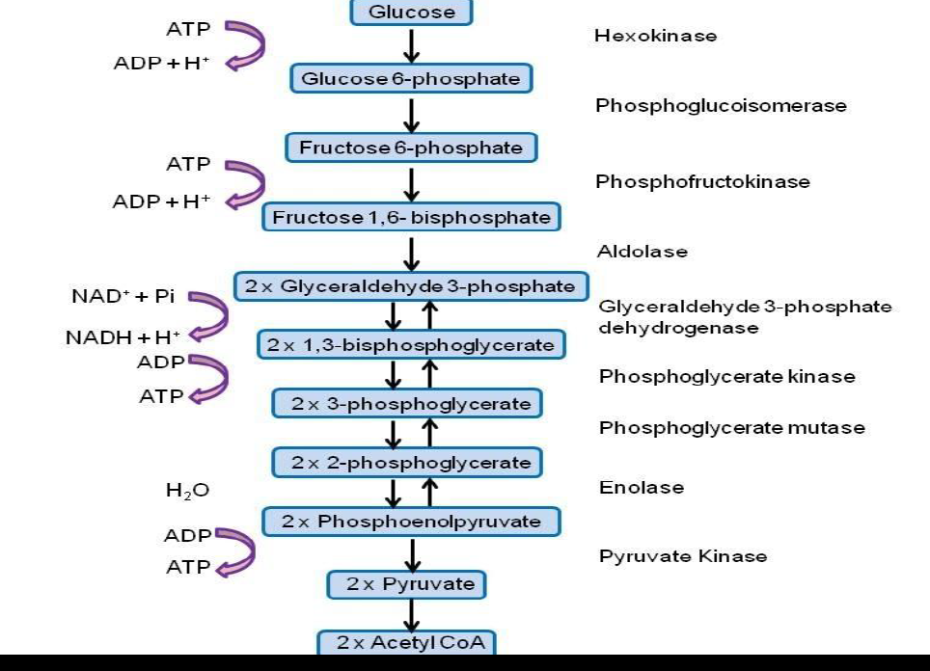
G
G-6-P

Slide 20
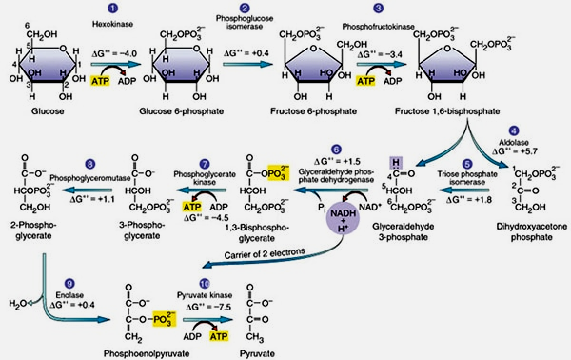

Slide 21
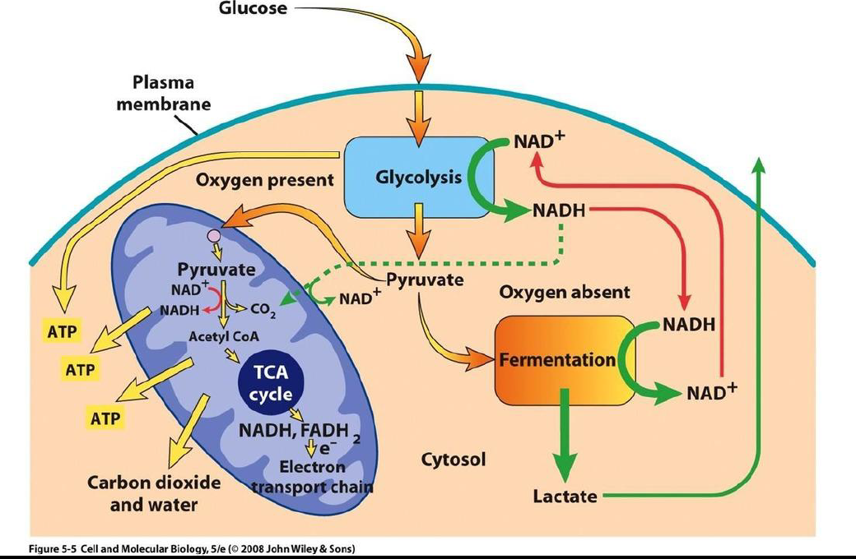

Slide 22
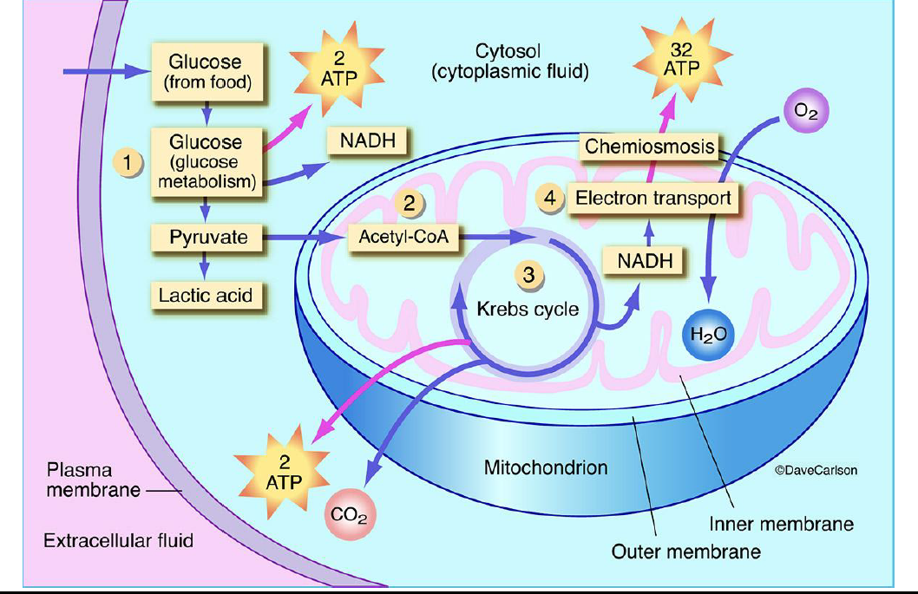

Slide 23
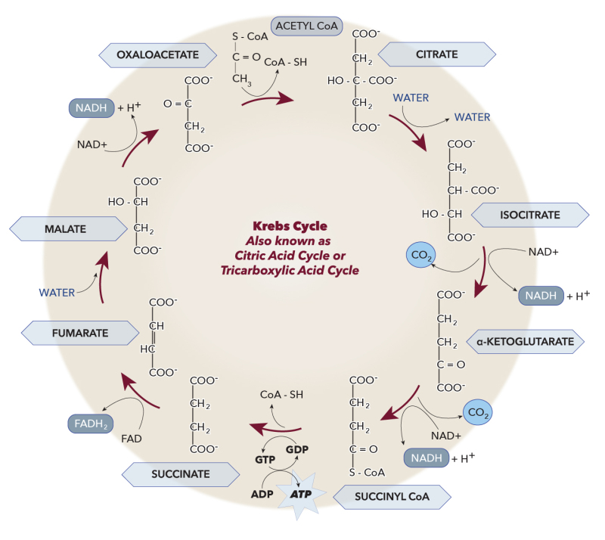

Slide 24
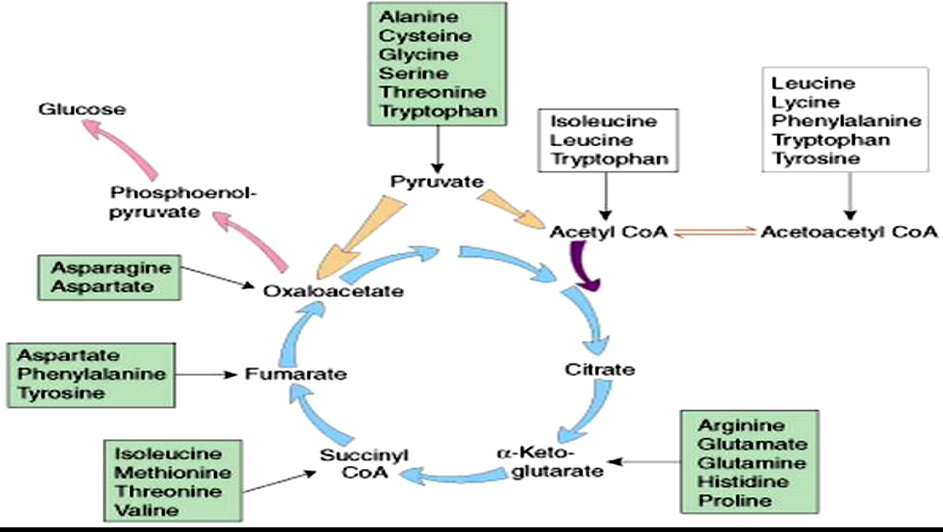

Slide 25
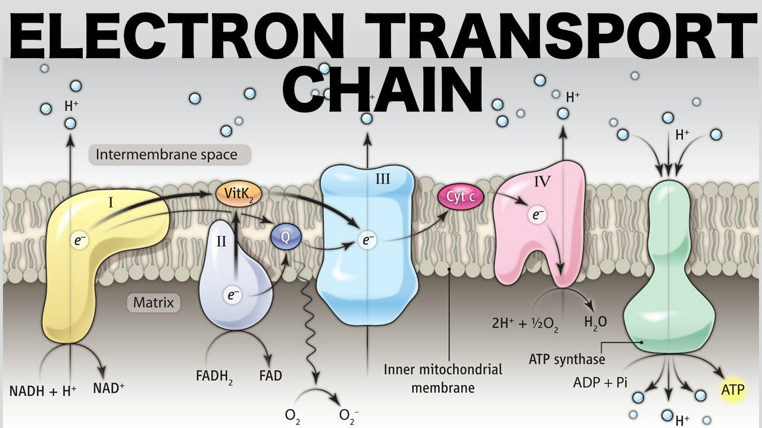
Proton gradient → Proton motive force

Slide 26
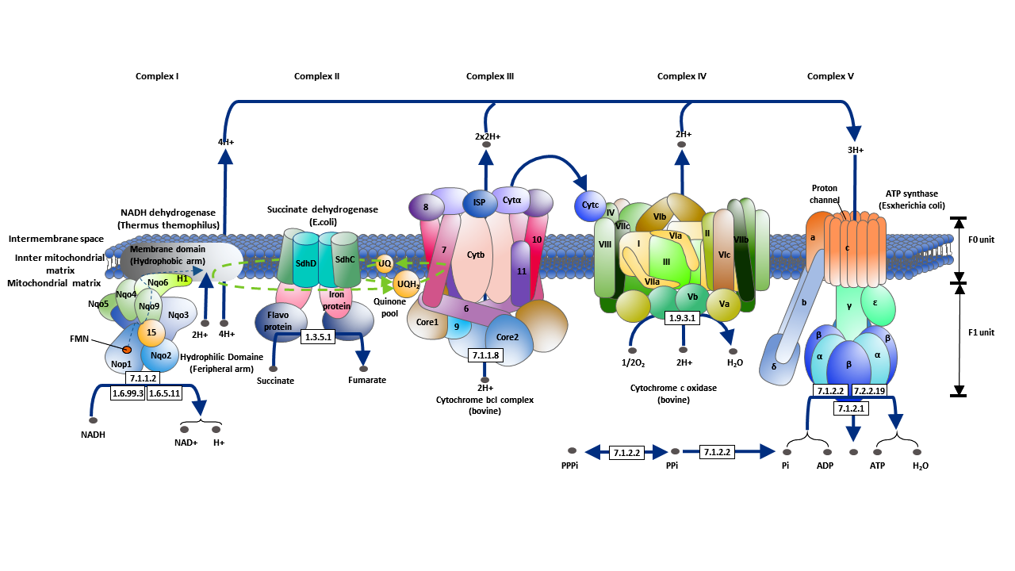
https://www.youtube.com/watch?v=k_DQ1FjFuYM

